Slide 1
RentIt: Smart Rental Platform with GenAI Concierge Chatbot
BY – PREETAM VALLABHANENI HARISHITHA CHOWDARY ALAPATI

Slide 2

RentIt is an object-oriented rental marketplace that lets users list and rent both properties (apartments/houses) and equipment (bikes, cars, tools, etc.) in a single platform. Hosts create listings, set pricing, and manage availability, while renters search and filter inventory, chat with a GenAI concierge for personalized recommendations and FAQs, and complete bookings through a simple payment prototype. The system focuses on core end-to-end rental workflows—listing management, discovery, booking, availability control, and confirmations—delivered as an operational prototype suitable for desktop or mobile deployment.

Slide 3
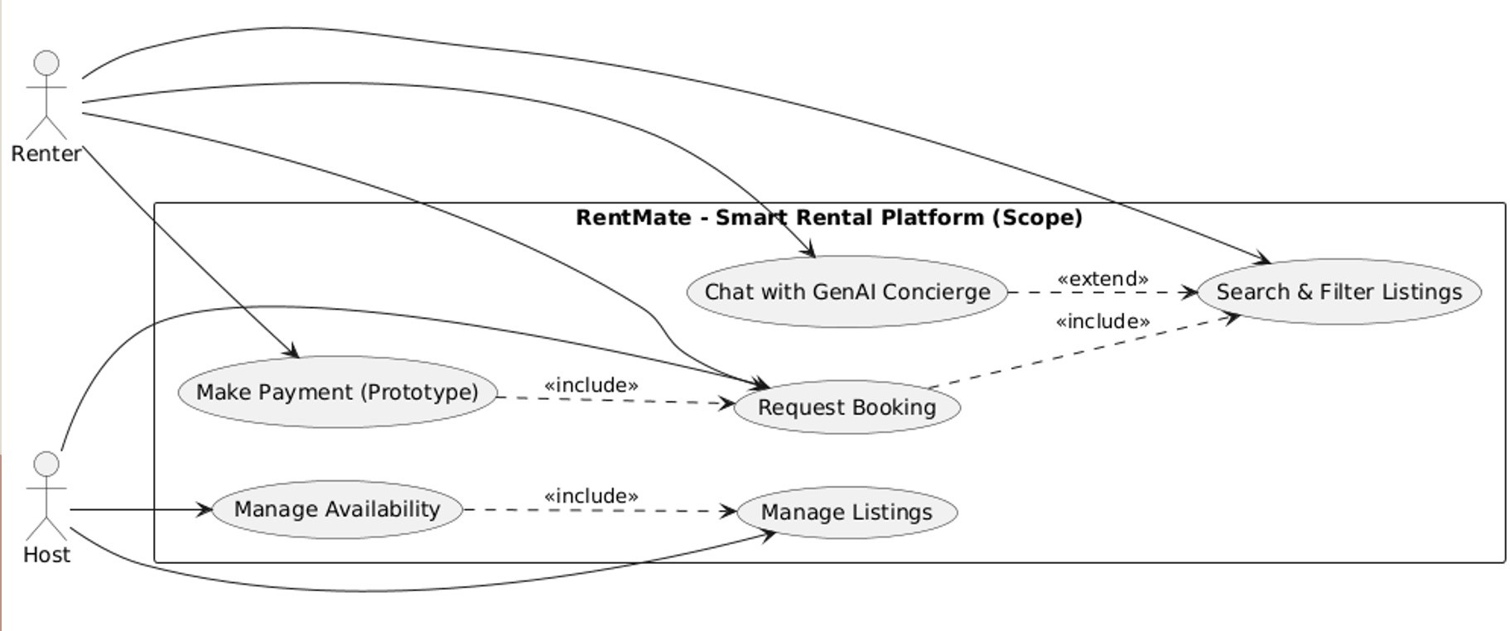
Use Case Diagram

Slide 4

there are 6 use cases. They are:
Chat with GenAI Concierge
Search & Filter Listings
Request Booking
Make Payment (Prototype)
Manage Availability
Manage Listings

Slide 5
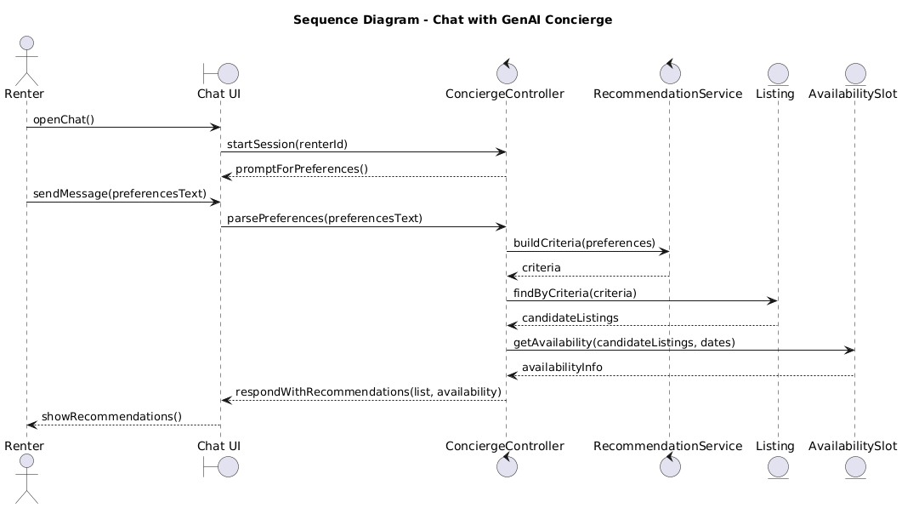

Slide 6
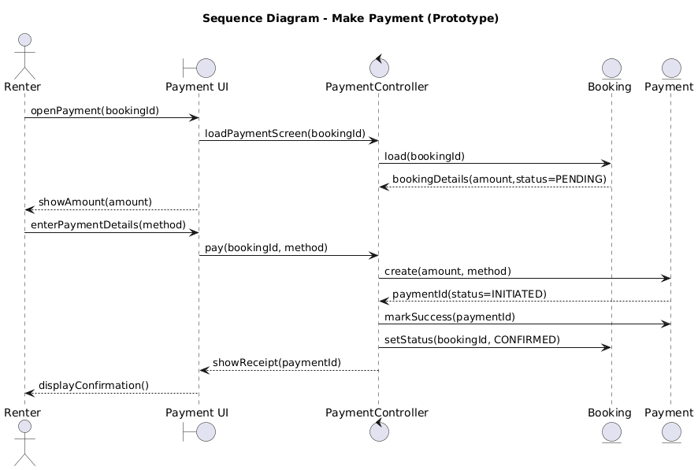

Slide 7
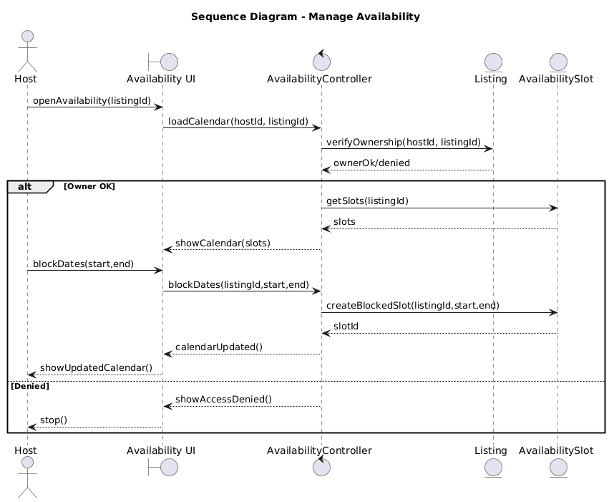

Slide 8
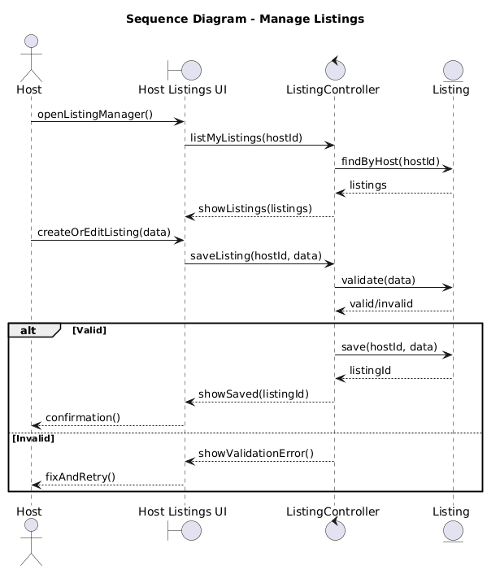

Slide 9
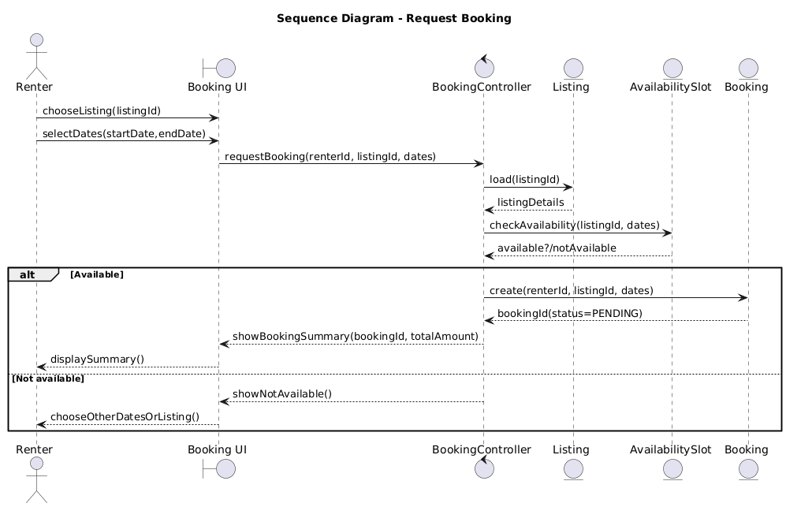

Slide 10
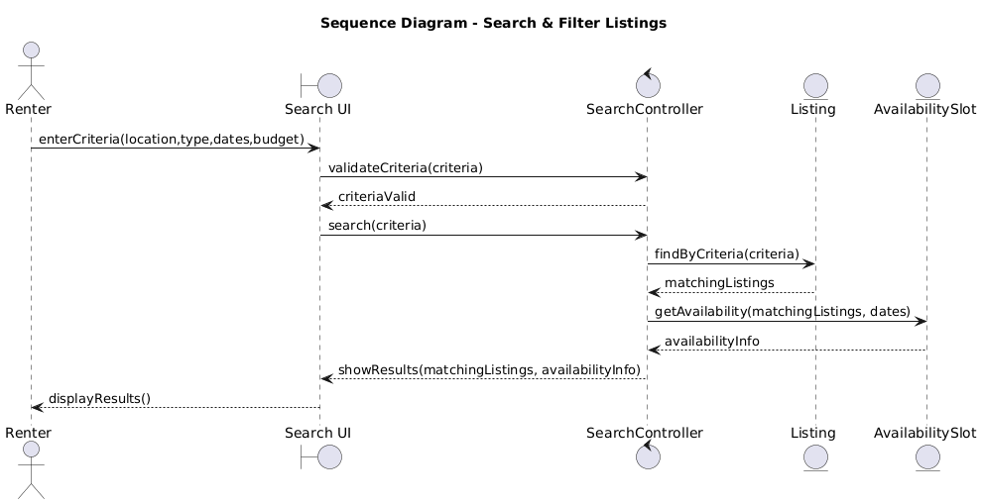

Slide 11
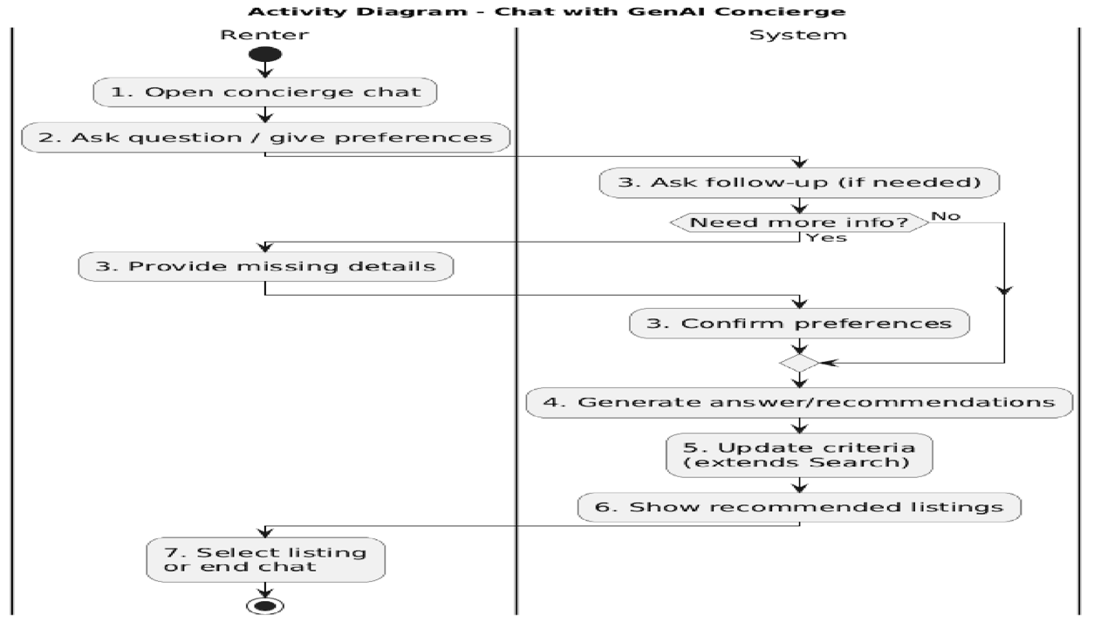

Slide 12
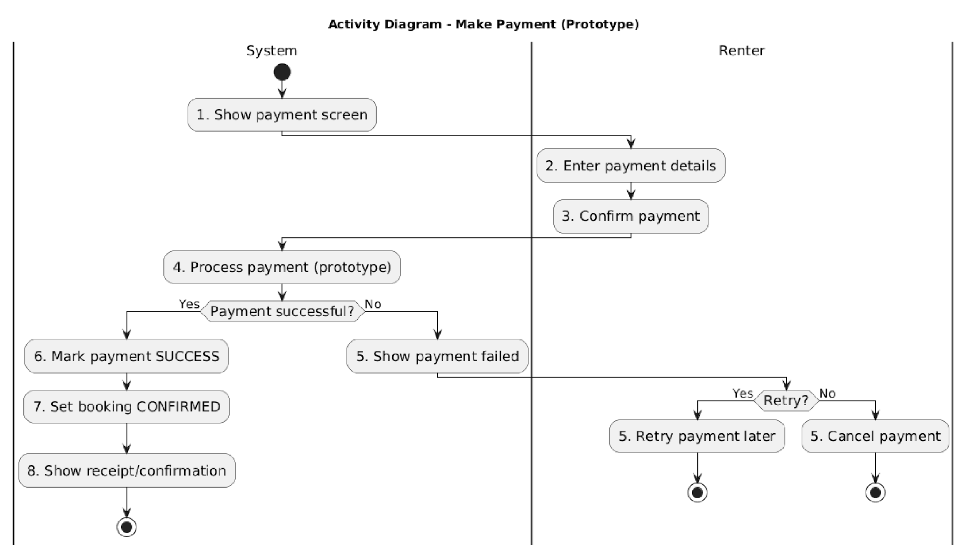

Slide 13
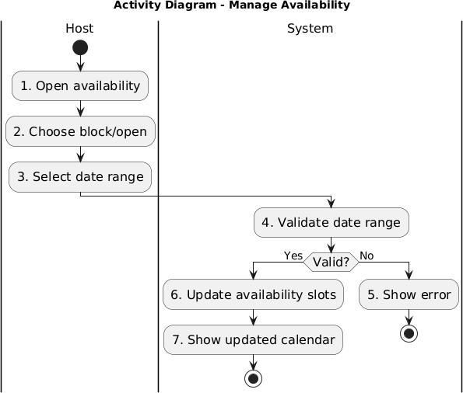

Slide 14
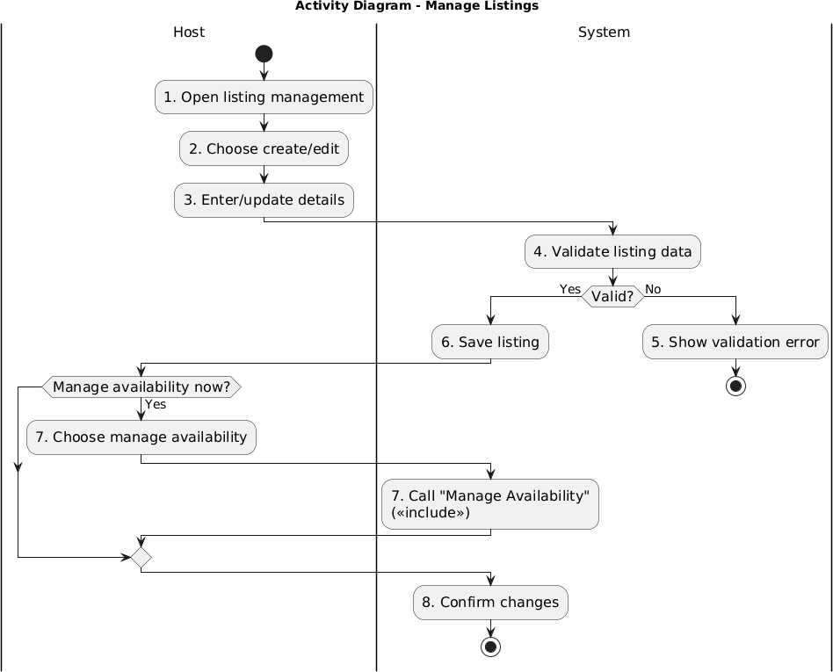

Slide 15
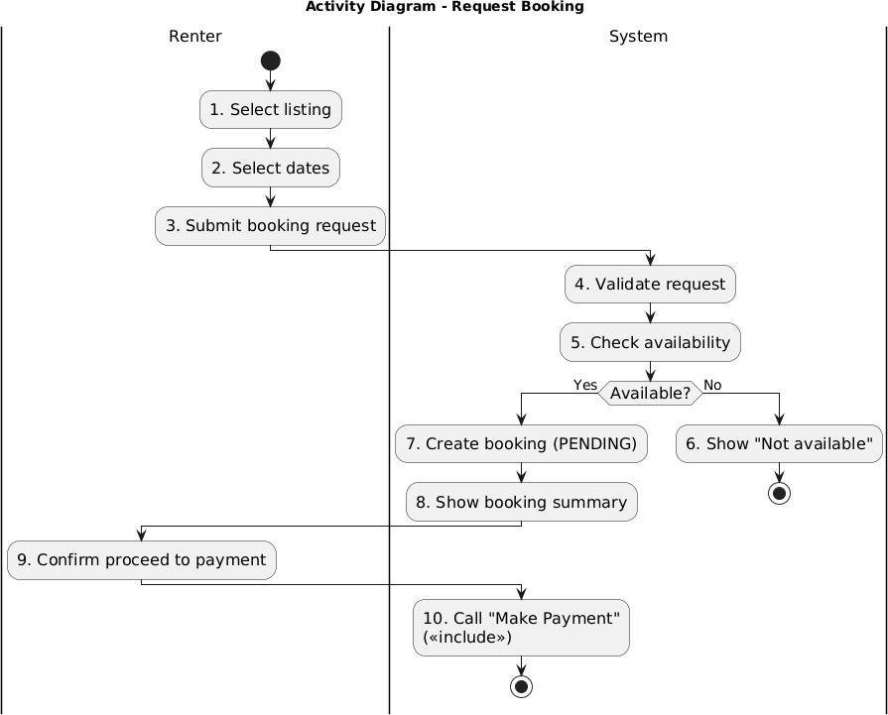

Slide 16
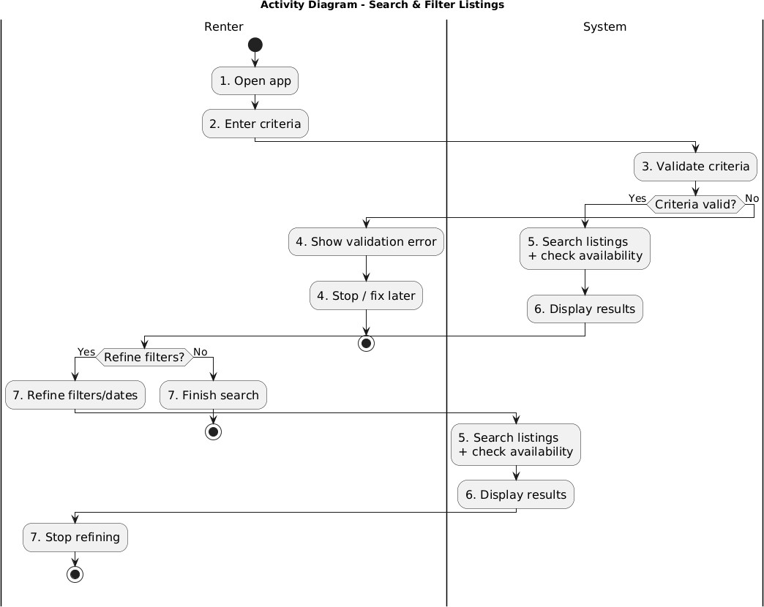

Slide 17
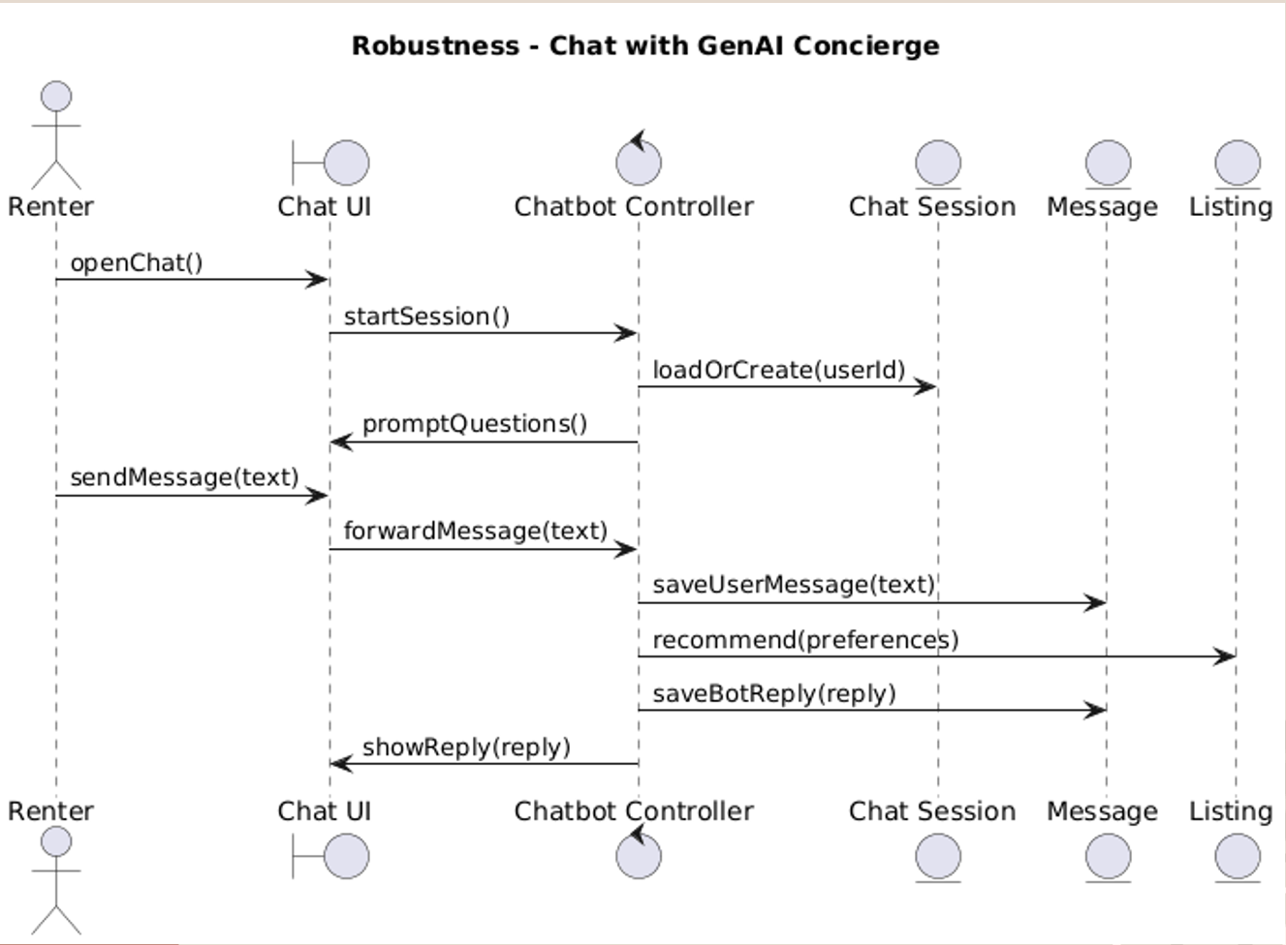

Slide 18
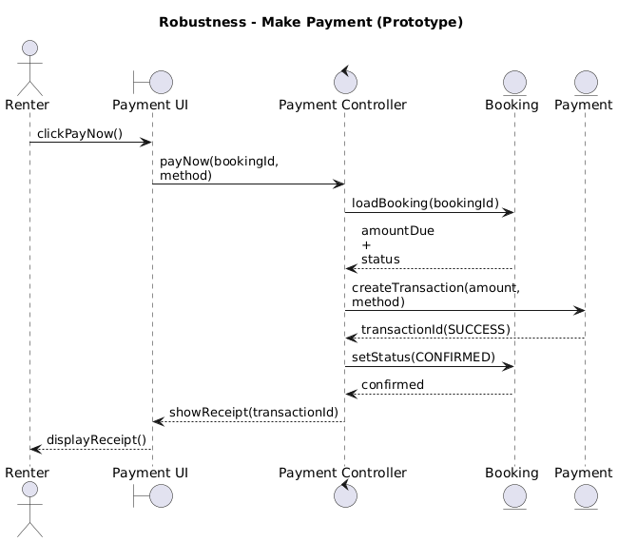

Slide 19
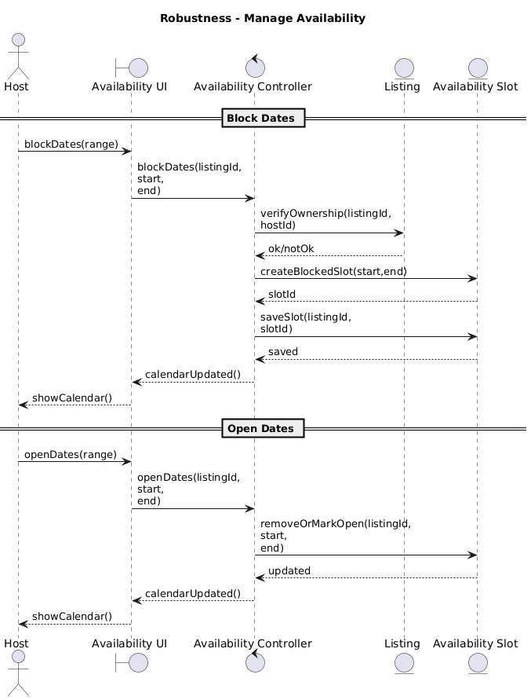

Slide 20
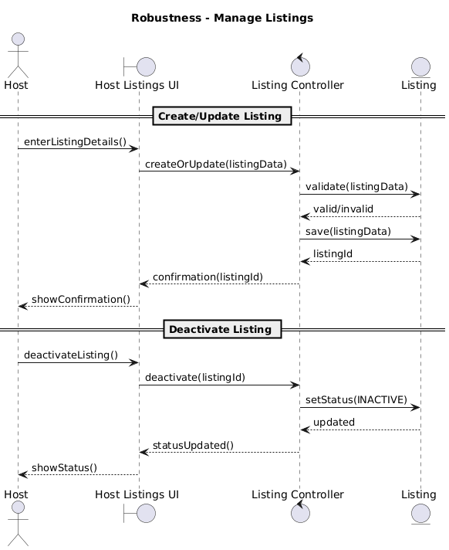

Slide 21
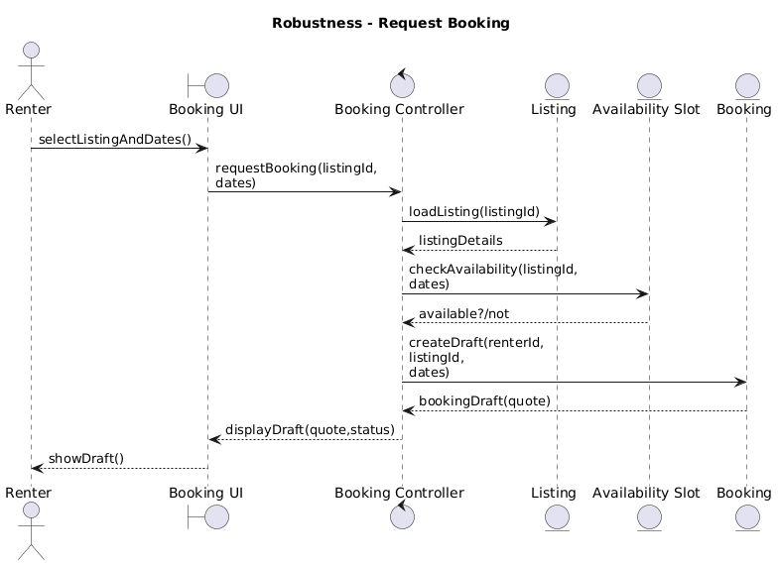

Slide 22
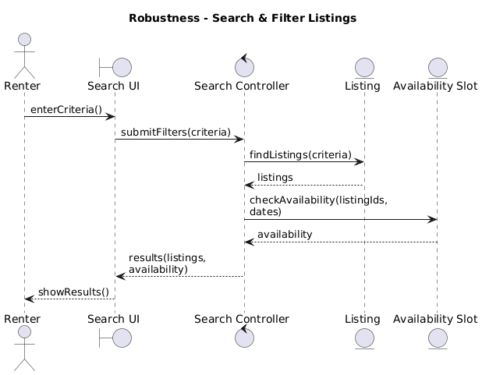

Slide 23
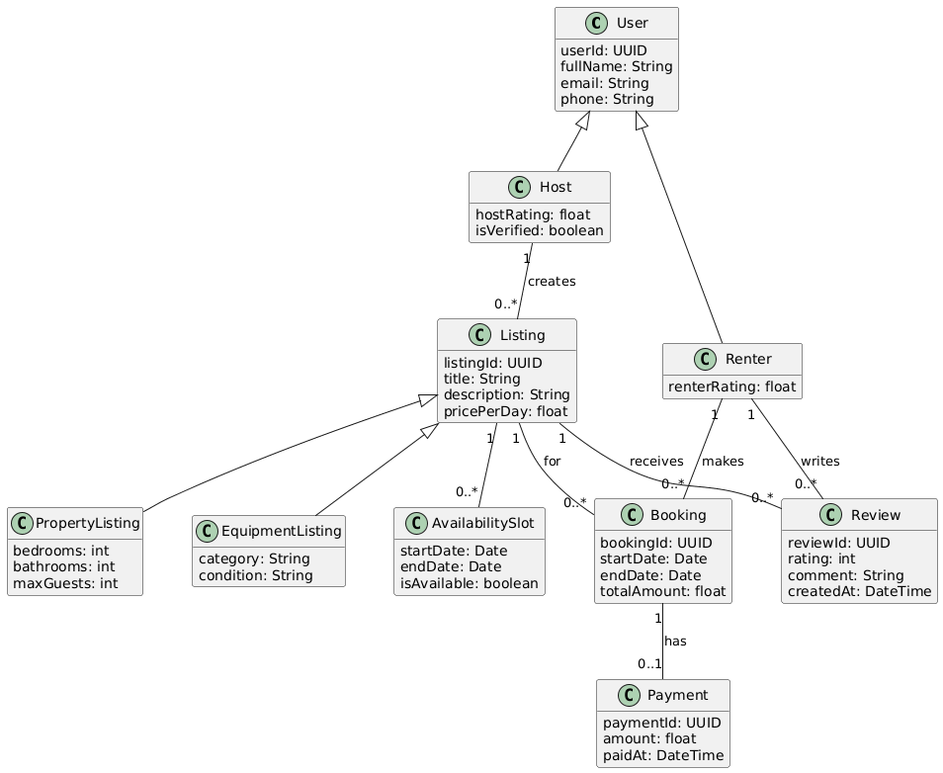
DOMAIN MODEL

Slide 24
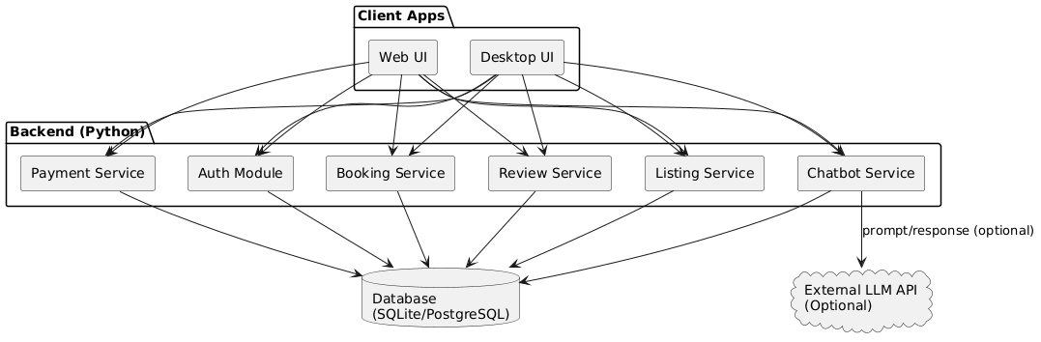
COMPONENT DIAGRAM

Slide 25
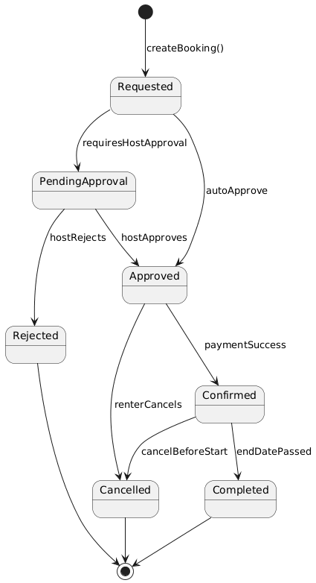
STATE DIAGRAM

Slide 26
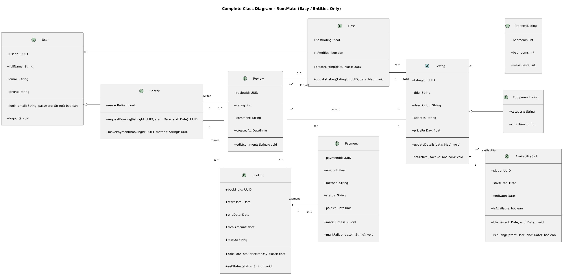

Slide 27
Thank You
-PREETAM VALLABHANENI HARISHITHA CHOWDARY ALAPATI

